Slide 1




University Institute of Engineering
Department of Computer Science & Engineering
COMPUTER ORGANIZATION & ARCHITECTURE
(23CST-204/23ITT-204)
ER. SHIKHA ATWAL
E11186
ASSISTANT PROFESSOR
BE-CSE

Slide 2
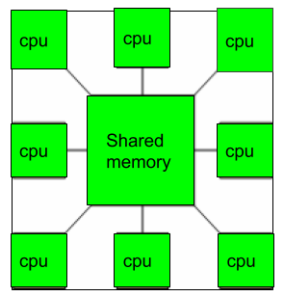
MULTIPROCESSOR
A Multiprocessor is a computer system with two or more central processing units (CPUs) share full access to a common RAM.
It boosts the system’s execution speed, with other objectives being fault tolerance and application matching.
There are two types of multiprocessors: shared memory (all the CPUs shares the common memory) and distributed memory multiprocessor (every CPU has its own private memory).

Slide 3
Characteristics of multiprocessors
A multiprocessor system is an interconnection of two or more CPUs with memory and input-output equipment.
The term “processor” in multiprocessor can mean either a central processing unit (CPU) or an input-output processor (IOP).
Multiprocessors are classified as MIMD system

Slide 4
Applications of Multiprocessor
As a multiprocessor, such as SIMD, which is usually used for vector processing.
Multiple series of instructions in a single perspective, such as MISD, which is used for describing hyper-threading or pipelined processors.
Inside a single system for executing multiple, individual series of instructions in multiple perspectives, such as MIMD is used.

Slide 5
Benefits of using a Multiprocessor
Enhanced performance.
Multiple applications.
Multi-tasking inside an application.
High throughput and responsiveness.
Hardware sharing among CPUs.

Slide 6
Disadvantages of Multiprocessor
Increased complexity
Higher power consumption
Difficult programming
Synchronization issues
Limited performance gains

Slide 7
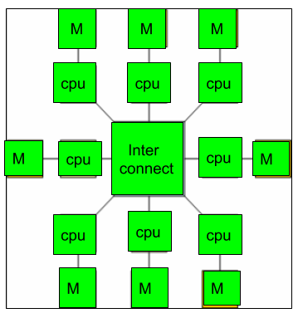
Multicomputer
A multicomputer system is a computer system with multiple processors that are connected together to solve a problem.
Each processor has its own memory and it is accessible by that particular processor and those processors can communicate with each other via an interconnection network.
Multicomputer can be used for distributed computing.
It is cost effective and easier to build a multicomputer than a multiprocessor.

Slide 8
Difference between multiprocessor and Multicomputer
Multiprocessor is a system with two or more central processing units (CPUs) that is capable of performing multiple tasks where as a multicomputer is a system with multiple processors that are attached via an interconnection network to perform a computation task.
A multiprocessor system is a single computer that operates with multiple CPUs where as a multicomputer system is a cluster of computers that operate as a singular computer.
Construction of multicomputer is easier and cost effective than a multiprocessor.
In multiprocessor system, program tends to be easier where as in multicomputer system, program tends to be more difficult.
Multiprocessor supports parallel computing, Multicomputer supports distributed computing.

Slide 9
Advantages of Multicomputer
Improved performance
Better scalability
Increased reliability
Reduced cost
Enhanced parallelism

Slide 10
Disadvantages of Multicomputer
Increased complexity
Higher power consumption
Difficult programming
Synchronization issues
Network latency

Slide 11
References
Reference Books:
J.P. Hayes, “Computer Architecture and Organization”, Third Edition.
Mano, M., “Computer System Architecture”, Third Edition, Prentice Hall.
Stallings, W., “Computer Organization and Architecture”, Eighth Edition, Pearson Education.
Text Books:
Carpinelli J.D,” Computer systems organization &Architecture”, Fourth Edition, Addison Wesley.
Patterson and Hennessy, “Computer Architecture”, Fifth Edition Morgaon Kauffman.

Slide 12
Other References
https://www.cs.vu.nl/~ast/books/mos2/sample-8.pdf
https://www.geeksforgeeks.org/introduction-of-multiprocessor-and-multicomputer/
https://poojavaishnav.files.wordpress.com/2015/05/unit-10_multiprocessors.pdf
https://www.coursehero.com/file/20342722/Multiprocessors/
Video Links:
https://youtu.be/hrcgK9rFkSU?si=IULJ65NETKUN1LIO
https://youtu.be/LO6Ta6kNbU0?si=1kktusZOGW82XrAh

